Slide 1



Weekly Progress: RAG Development with LangChain with 1M Dataset
On Development of an on-Premise AI Product Recommendation Model Using Open-Source LLM
Monir (248810)
23 April 2025
Department of Artificial Intelligence Convergence

Slide 2

Project Description
Project Title
Development of an on-Premise AI Product Recommendation Model Using Open-Source LLM
Company: Narosu Co. Ltd.
Project Description
The e-commerce market is becoming increasingly competitive, requiring advanced recommendation systems.
Large marketplaces use sophisticated AI models, but independent online store operators lack such solutions.
This project aims to develop an AI-powered product recommendation system tailored for self-managed online stores.
By analyzing customer preferences, the system will suggest products that align with their interests.
Project Objective
Develop an AI-based search and recommendation system that analyzes user input sentences and recommends the TOP 5 most relevant products based on semantic similarity.
Utilize Natural Language Processing (NLP) and vector search technology to provide a highly refined search experience.
Deploy in an on-premise environment to ensure data privacy and full control over the recommendation process.
1

Slide 3

Company Requirements
Selected Model and Vector Store:
Embedding Model: text-embedding-ada-002
Vector DB/Search: Qdrant
LLM Reasoning: Llama 3.1 8B instant
LangChain Framework for LLM
UI Framework: Gradio
API Architecture: Gradio + FastAPI
2

Slide 4

System Configuration (AI Model) Diagram
3

Slide 5
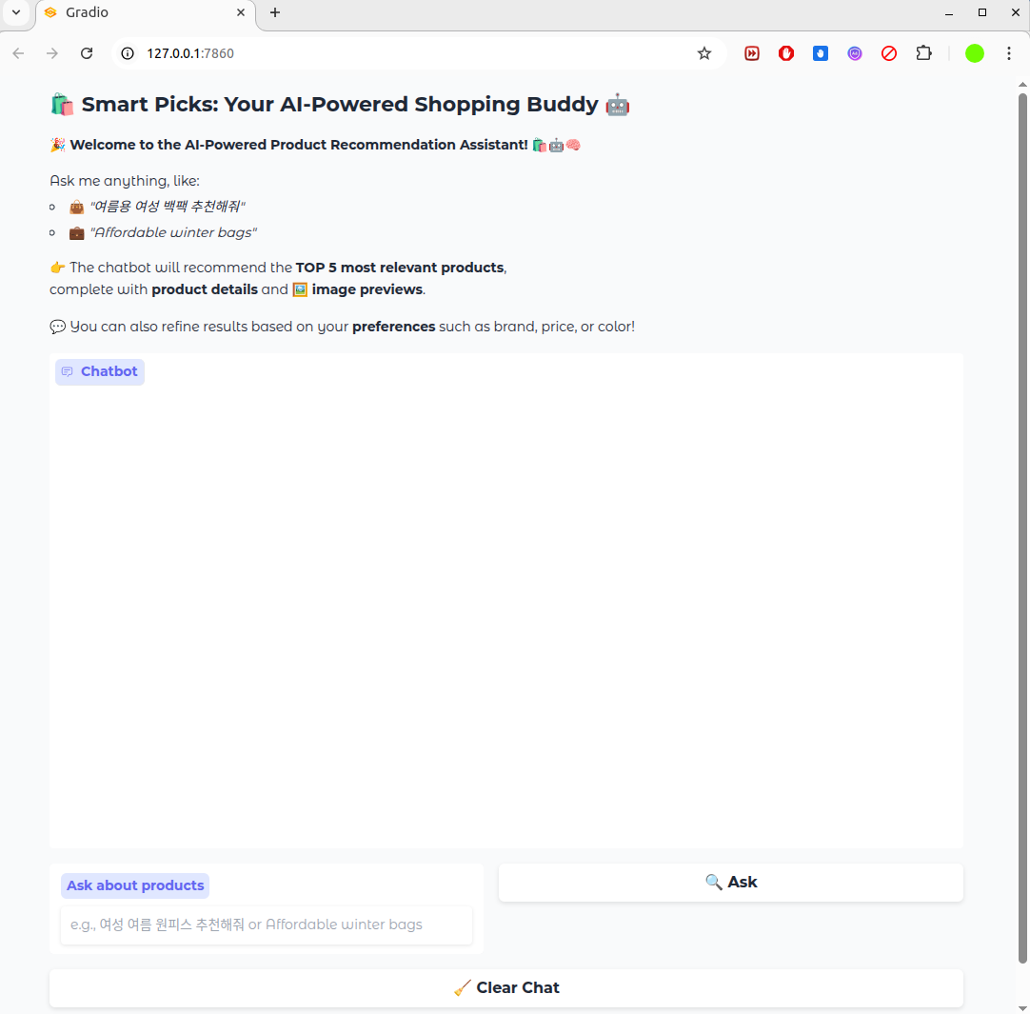
ChatBot User Interface (UI) Using Gradio
4

Slide 6
Project Schedule (Gantt Chart)
Phase | 2025
 | March |  |  |  | April |  |  |  | May |  |  |  | June
 | 1 | 2 | 3 | 4 | 1 | 2 | 3 | 4 | 1 | 2 | 3 | 4 | 1 | 2
Project Understanding and Data Collection
Data Analysis and Pre-processing
Model Selection and Training
System (RAG) Development
Chatbot Development
Testing and Deployment
5

Slide 7
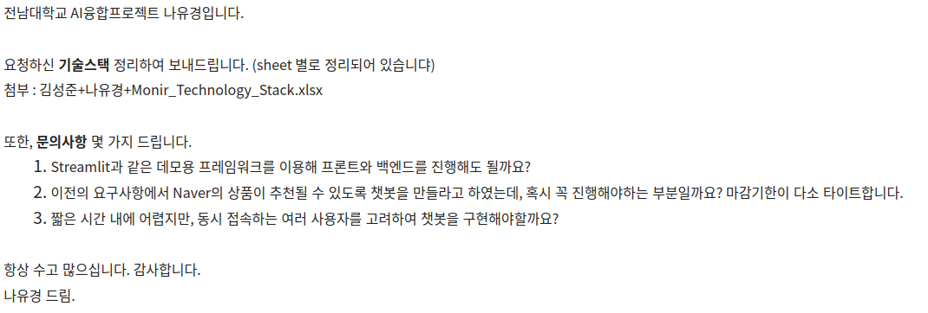
Communication with Company
Asked some queries to the company:
6

Slide 8
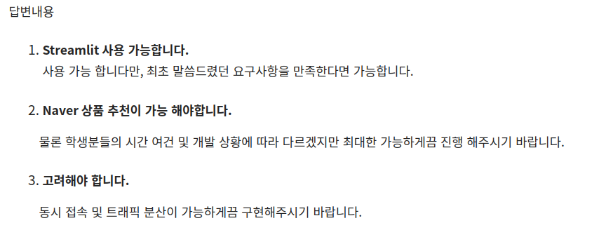
Communication with Company
Responses from the company:
7

Slide 9
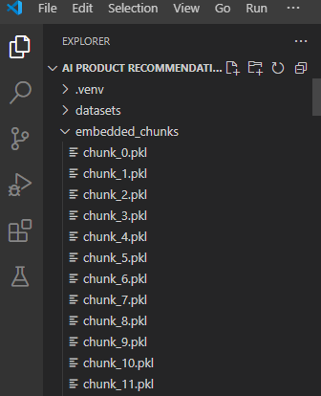
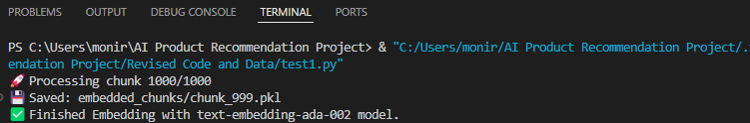
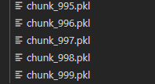
Embedding completed on 1M Dataset (1000 Chunks)
It takes 5 days to embed 1000 chunks (1M).
…
8

Slide 10
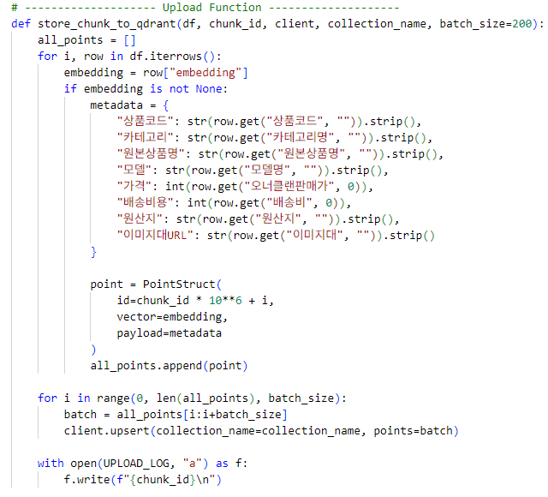

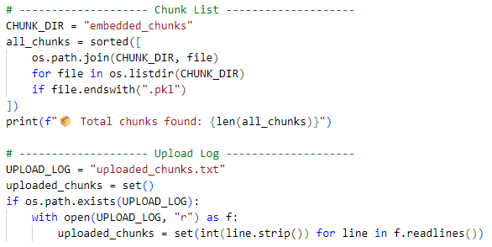
Storing embedded 1000 Chunks on Qdrant
Qdrant setup and store embeddings as a chunks on it.
9

Slide 11
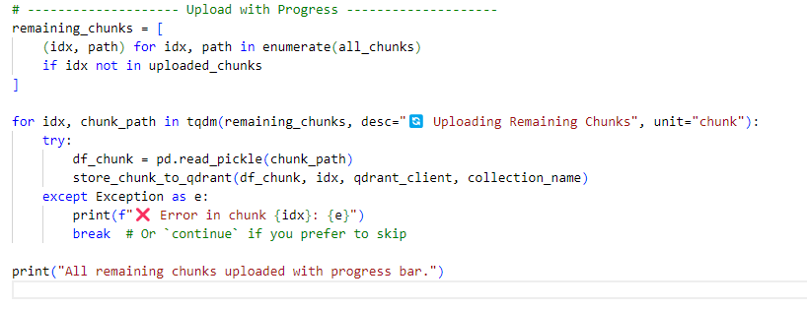
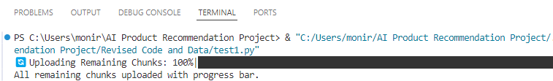
Storing of 1000 Chunks completed on Qdrant
Uploading chunks on qdrant vector database.
10

Slide 12
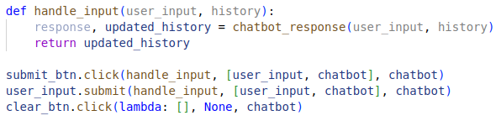
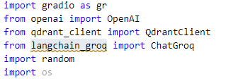
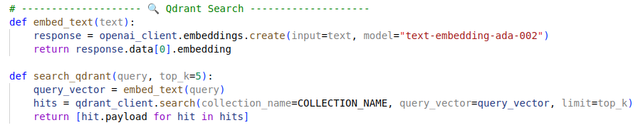

RAG Implementation with LangChain
User Query from the Gradio UI
Embedded the query and search on qdrant.
Fetching data from qdrant
11

Slide 13
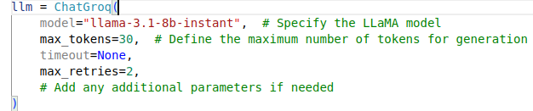
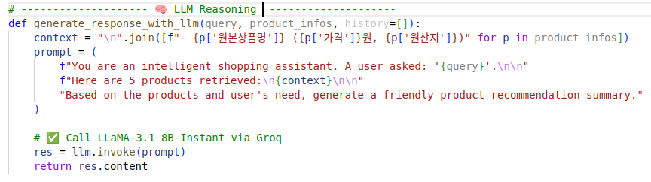
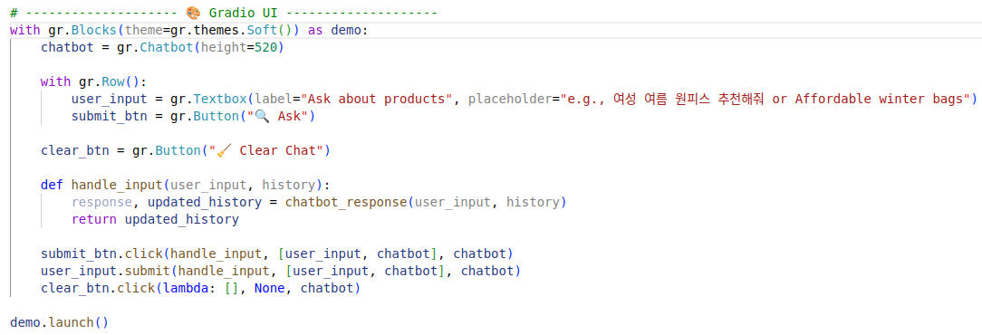
RAG Implementation with LangChain
4. Initialize the LLaMA model parameters
5. LLM Reasoning for generating response
6. Launching Chatbot with Gradio
12

Slide 14
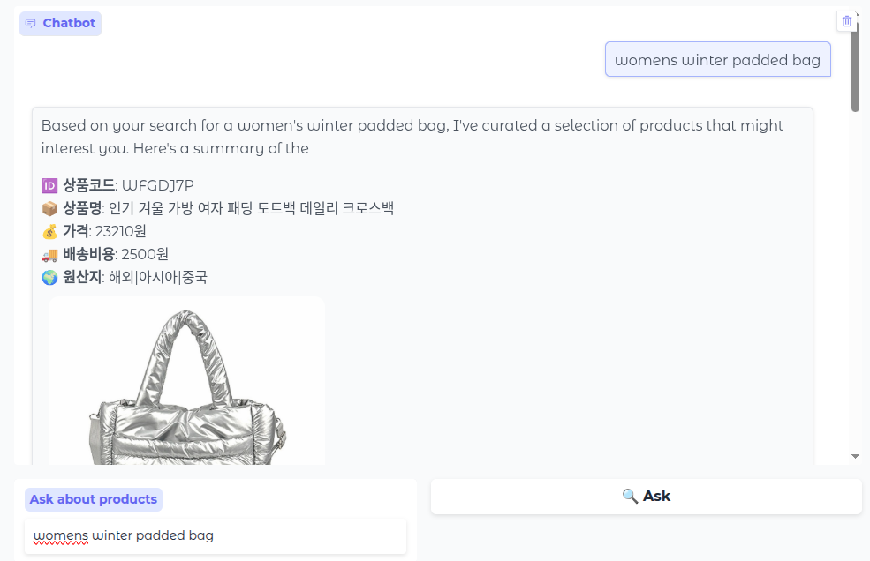
Launching Chatbot with a query
Try with a query: womens winter padded bag
13

Slide 15
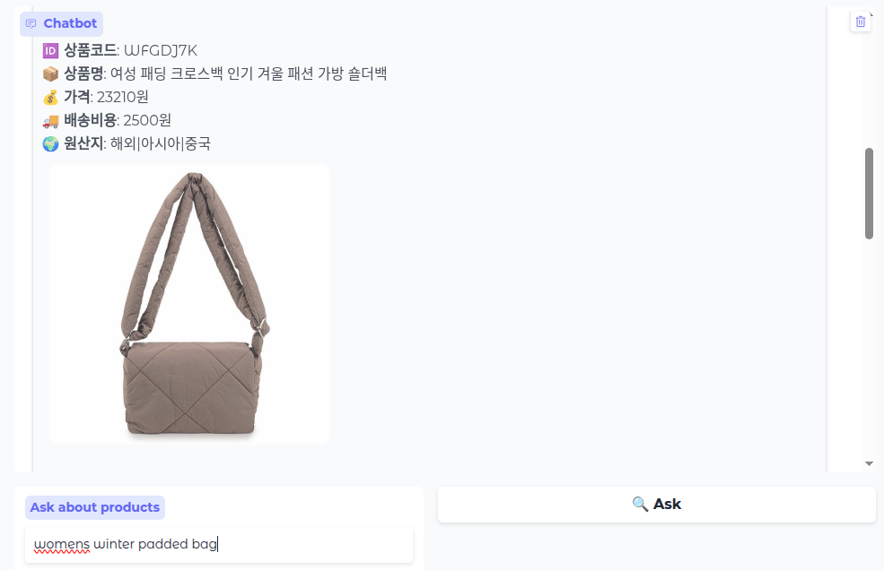
Testing Chatbot with a query
All the response are correct and well structured.
14

Slide 16
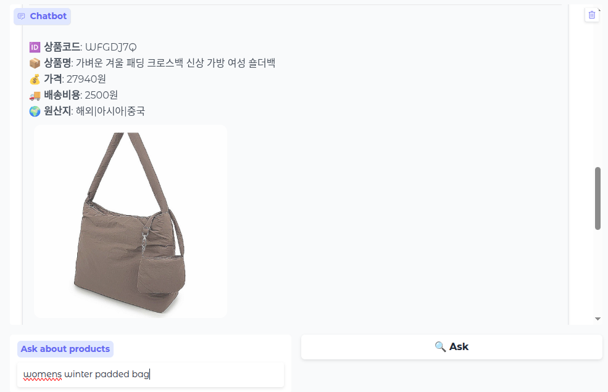
Testing Chatbot with a query
All the response are correct and well structured
15

Slide 17
Thank You for Listening.
16

